Slide 1
Checkoff #1 – Glove software
Berfin Snow Bircan

Slide 2
Goals
Q1
Turn pseudocode into actual code to get values from the accelerometer
Q2
Do sampling to get error values for accelerometer and gyroscope and set a baseline
Q3
Implement thresholding
Q4
Test outputs to ensure correct with hardware

Slide 3
Sampling - Gyroscope
GyroErrX | GyroErrY | GyroErrZ
-3.59 | 0.64 | -1.85
-4.12 | 0.05 | -1.73
-4.09 | 0.35 | -1.75
-4.14 | 0.09 | -1.15
-4.15 | -0.03 | -1.61
*Each row is an average of 200 samples
Average of 1000 samples
GyroErrX | GyroErrY | GyroErrZ
-4.02 | 0.22 | -1.62

Slide 4
Sampling - Accelerometer
AccErrX | AccErrY | AccErrZ
-0.02 | -0.03 | 0.98

Slide 5
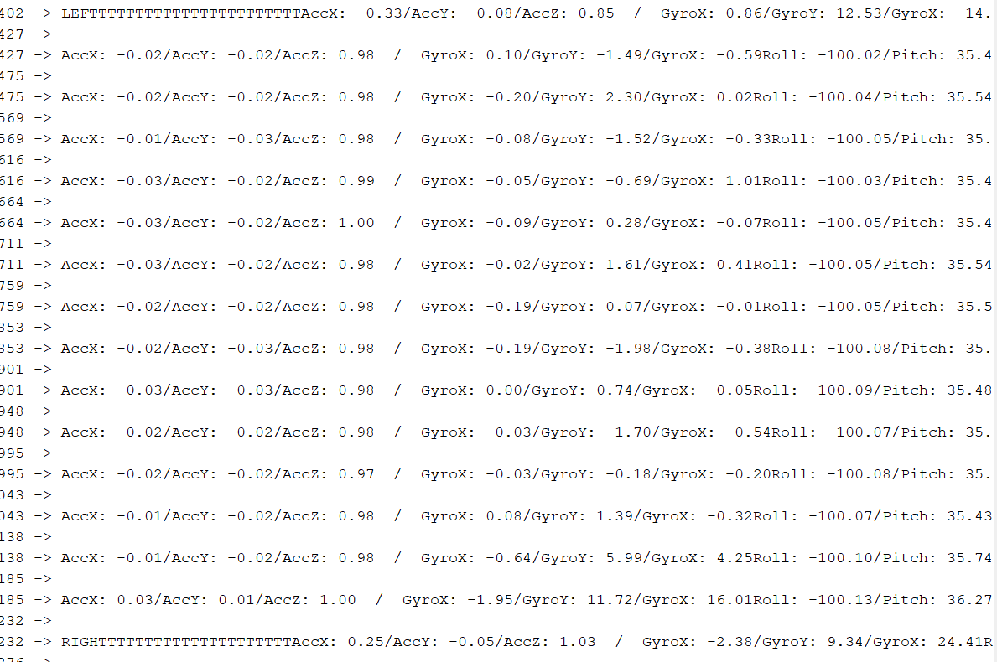
Thresholding with serial Output

Slide 6
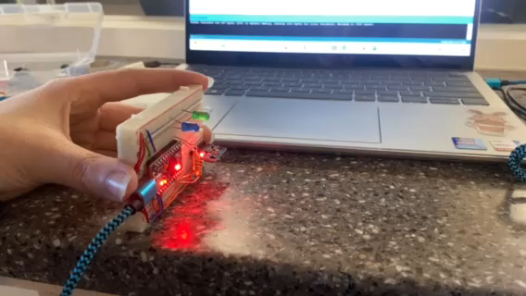
Thresholding Testing

Slide 7
Thank you
Any Questions?

